Slide 1

University of science and Technology, Meghalaya
Department of Computer Science and Electronics
Topic – Student Information System
Paper code – BCA 404
Presented by-
Gaurab Roy(17/BCA/44)
Rupanjan Sarkar(17/BCA/12)

Slide 2
Contents
System Overview
Problem in the current System
Proposed System
Advantage of using SIS
Tools and Technology used
Zero level data flow diagram
First level data flow diagram
ER Diagram
Table Structure

Slide 3
System Overview
To overcome the problems existing in the manual system.
Designed for the particular need of the administration.
Developed to speed up the operations as much as possible and to avoid errors.
Lead to error free, secure, reliable and fast management system.

Slide 4
Problem in the current System
Records are written on Microsoft Excel sheet and paper.
Time Consumption is very huge with lack of security.
Unauthorized person can get access to all the information.
Student’s data can be modified without any permission.

Slide 5
Proposed System
Developed to store student details.
Reduce the workload that exist in the manual system.
Minimizing the probability of losing any data.
More work in a very less amount of time.
More secure than the existing system.

Slide 6
Advantages of using SIS
Developed to store student details.
Provides smart management of student’s data.
Viewing of Student’s information based on enrollment number.
More work in less time.
Accuracy in works.
Well designed reports.

Slide 7
Tools and Technology used
Hardware Specifications
Processor: Intel Core i3
Hard Disk: 1 TB
RAM: 4GB DDR3
Processor Variant: 6006U
Software Used
Operating System: Microsoft Windows 10
Front End: Microsoft Visual Studio 2008
Back End: MySQL Server 2005

Slide 8
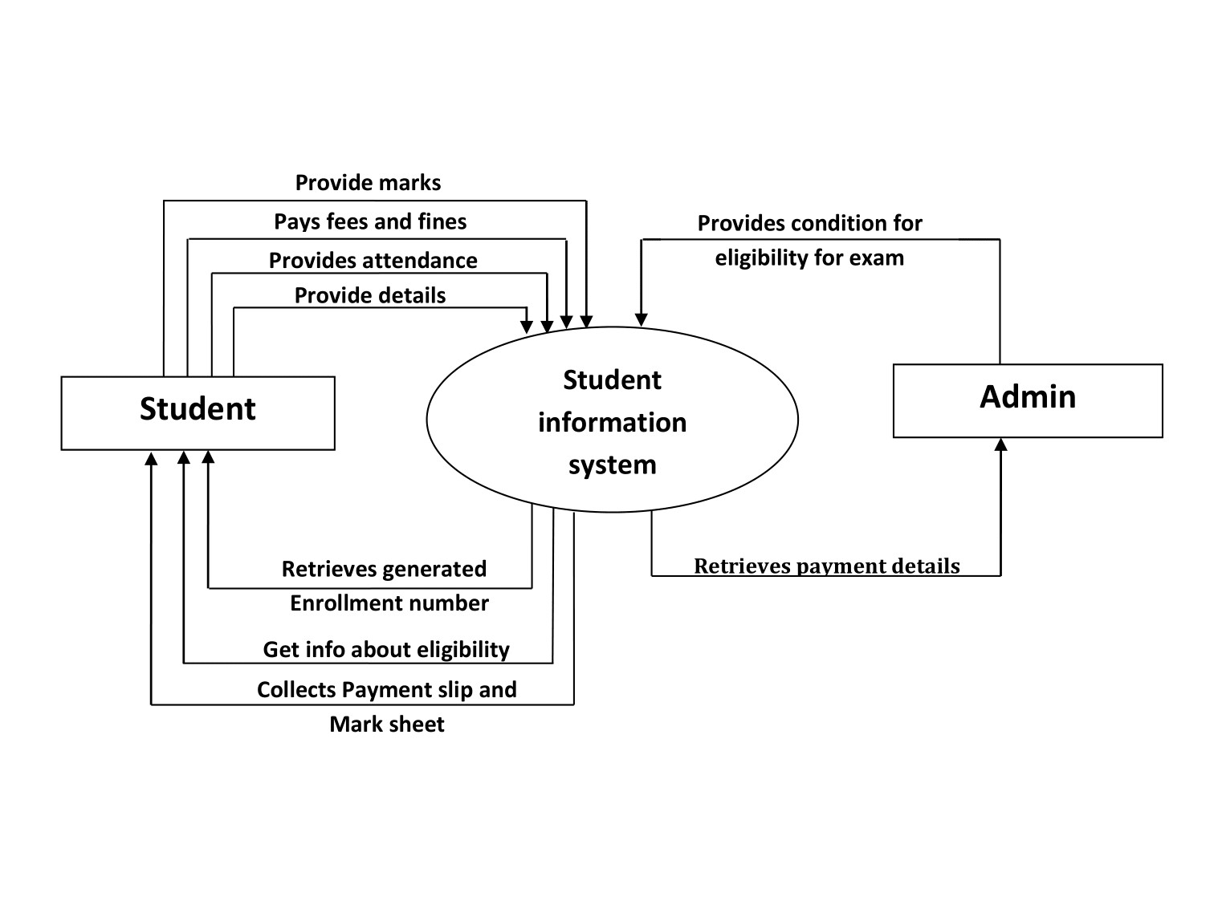
Zero level Data Flow Diagram

Slide 9
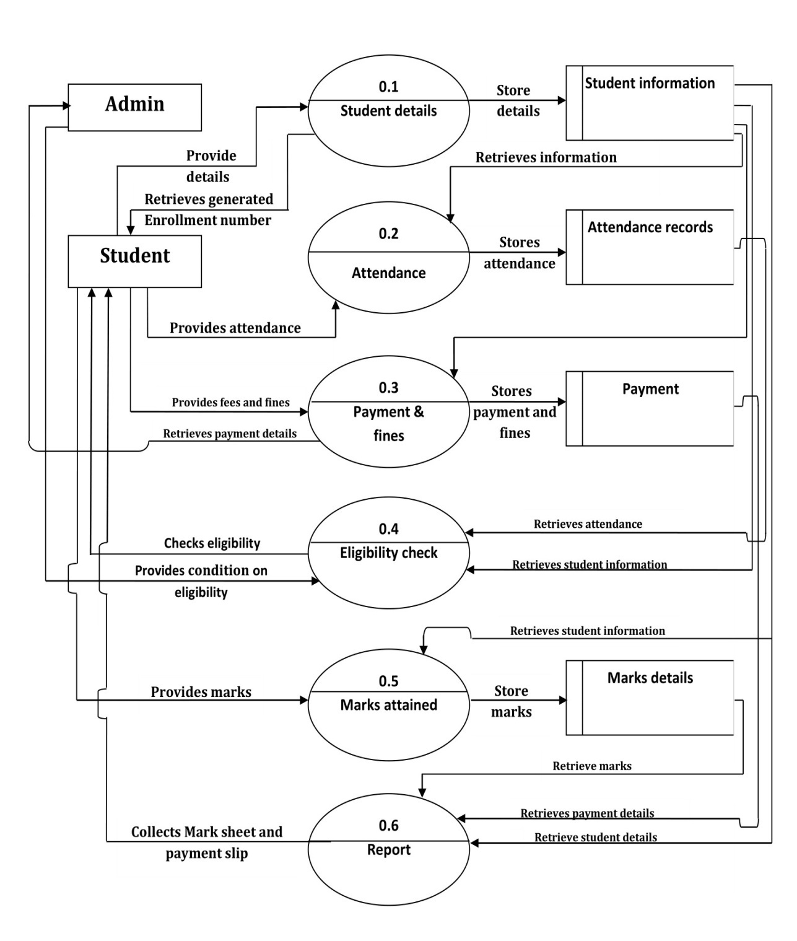
First level Data Flow Diagram

Slide 10
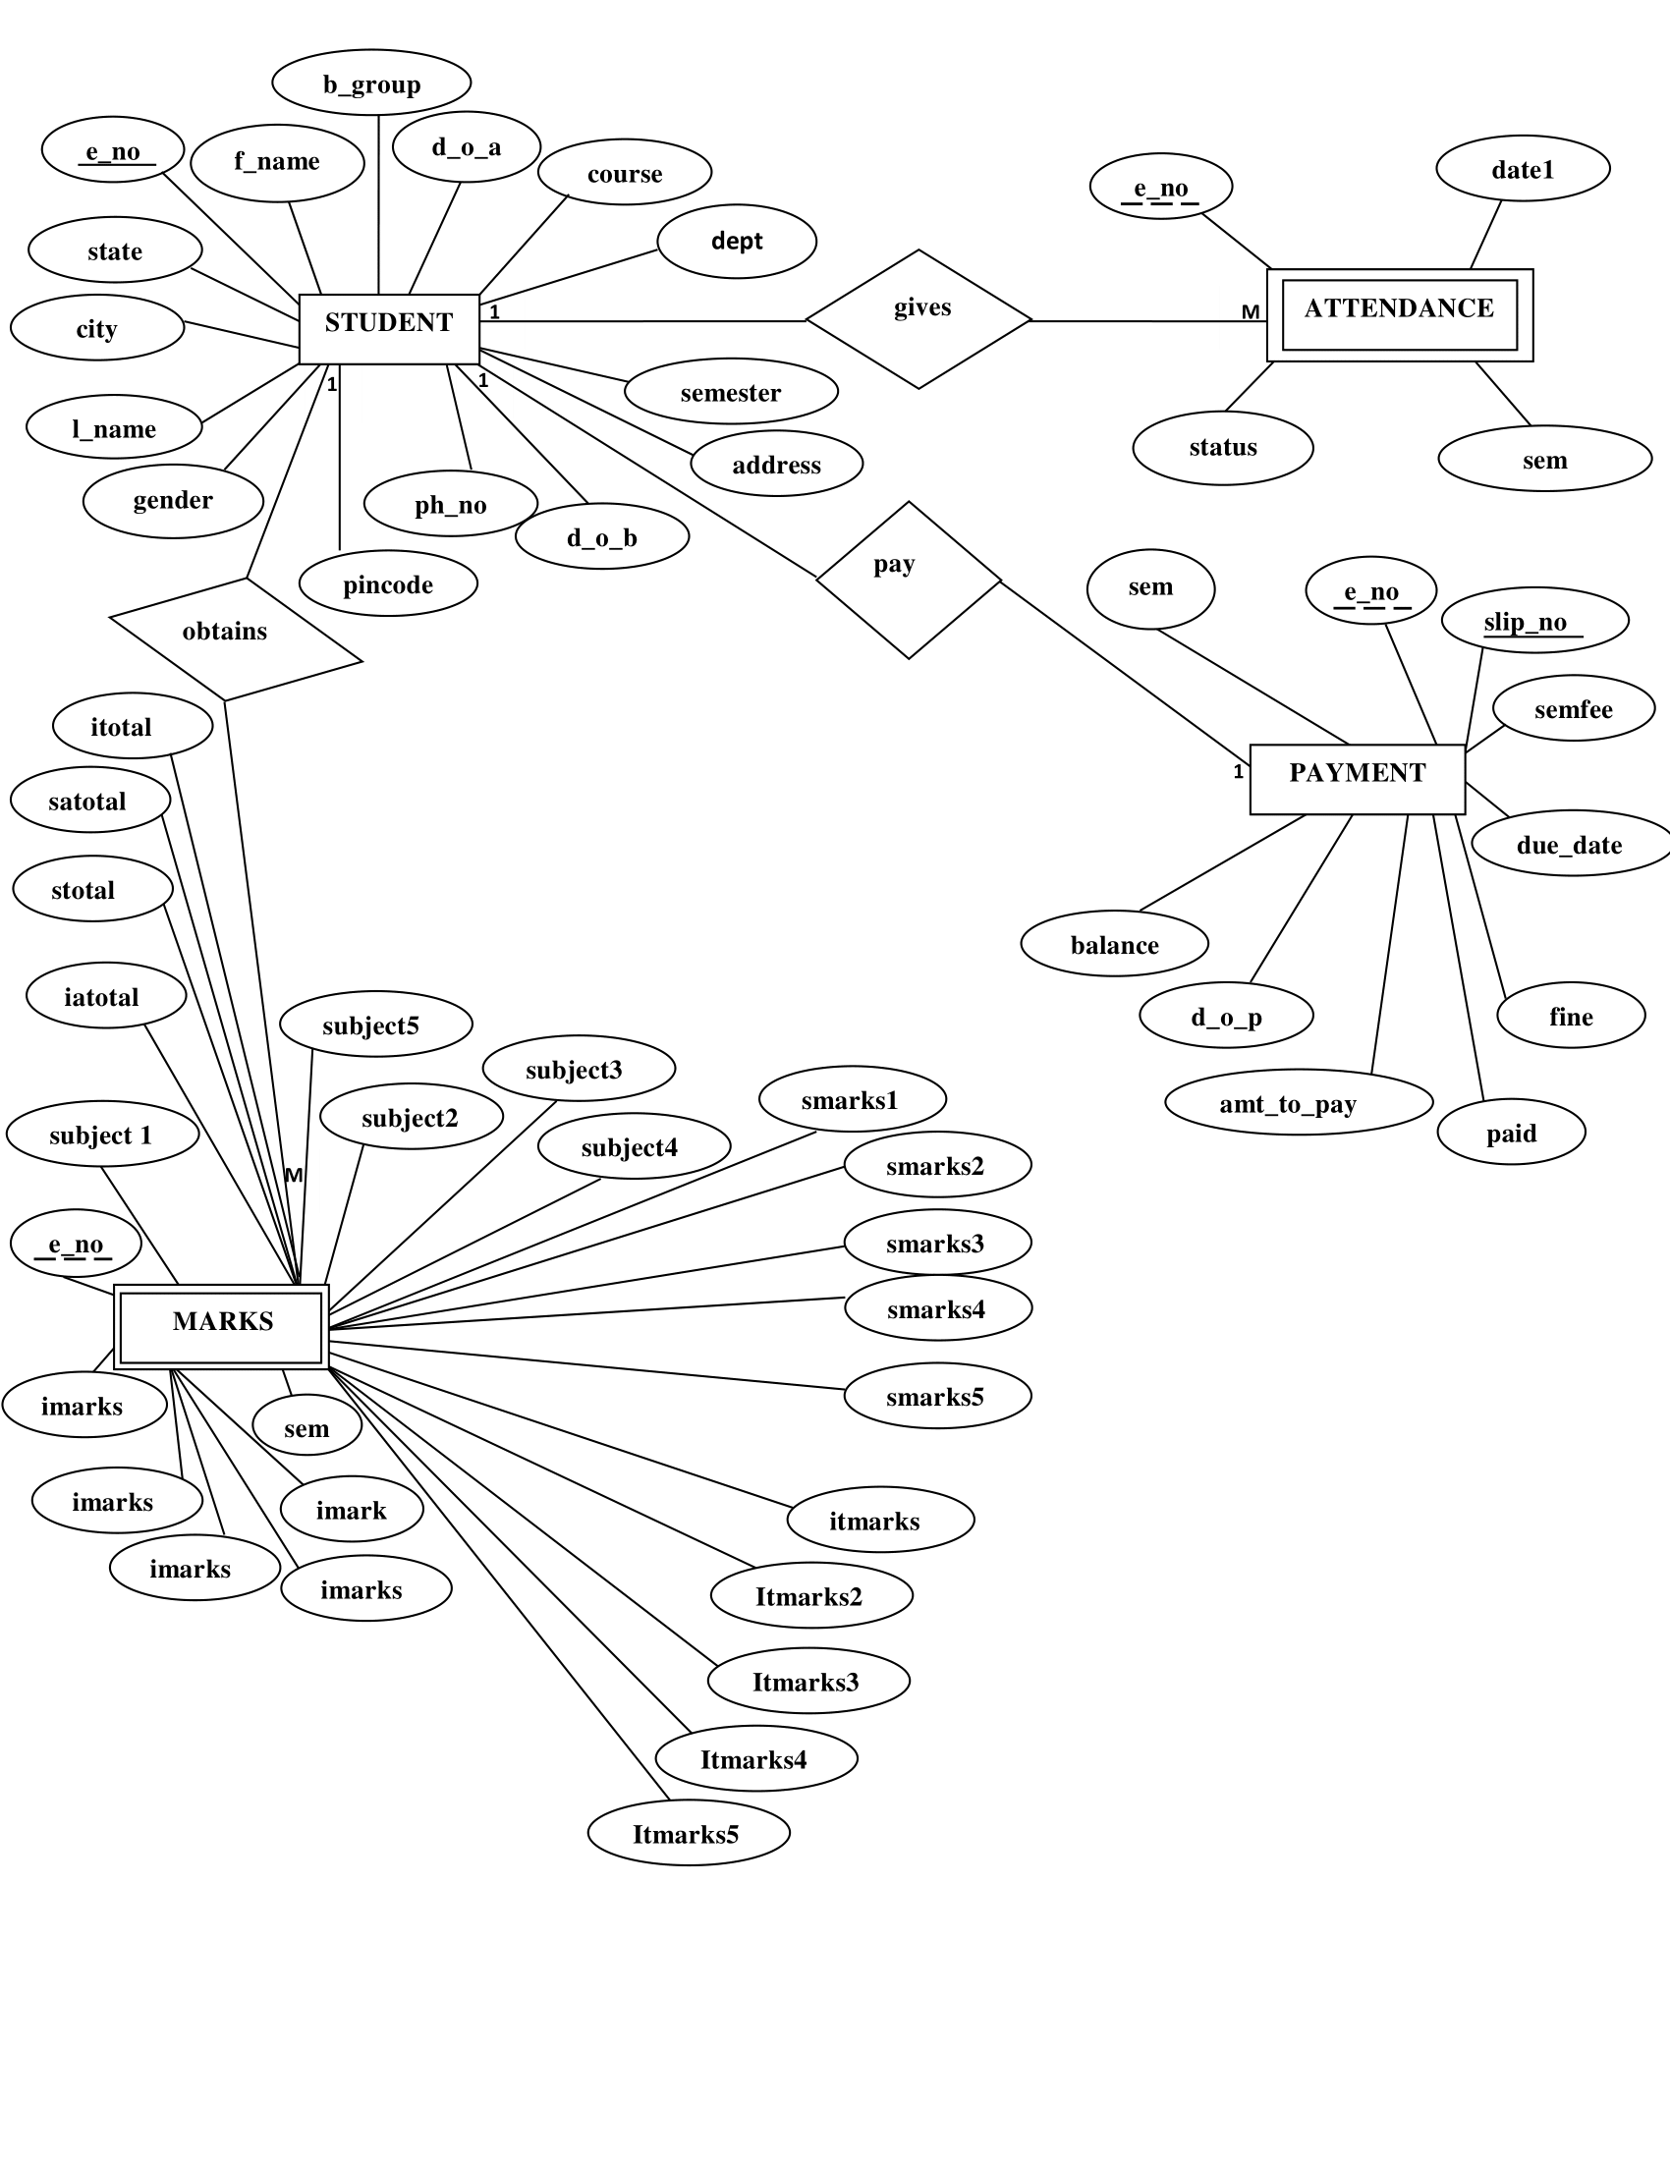
ER Diagram

Slide 11
Data Dictionary
Field Name | Description | Source table | Constraint
address | Student's Address | Student
amt_to_pay | Amount to be paid | Payment
b_group | Blood group | Student
balance | Payment balance | Payment
city | City where student lives | Student
course | Course taken by student | Student
d_o_a | Date of admission | Student
d_o_b | Date of birth | Student
d_o_p | Date of payment | Payment
date1 | Date of Attendance | Attendance
dept | Department of the student | Student
due_date | Due date | Payment
e_no | Enrollment number | Student | primary key
f_name | First Name of the student | Student
fine | Fines | Payment
gender | Gender of the student | Student
iatotal | Internal exam total marks achieved | Marks
imarks1 | Internal exam subject 1 marks | Marks
imarks2 | Internal exam subject 2 marks | Marks
imarks3 | Internal exam subject 3 marks | Marks
imarks4 | Internal exam subject 4 marks | Marks
imarks5 | Internal exam subject 5 marks | Marks
itmarks1 | Internal exam subject 1 total marks | Marks
itmarks2 | Internal exam subject 2 total marks | Marks
itmarks3 | Internal exam subject 3 total marks | Marks
itmarks4 | Internal exam subject 4 total marks | Marks
itmarks5 | Internal exam subject 5 total marks | Marks
itotal | Internal exam all subject total marks | Marks
l_name | Last Name of the student | Student

Slide 12
paid | Payment paid | Payment
ph_no | Phone number of the student | Student
pincode | Pin code | Student
satotal | Semester exam total marks achieved | Marks
sem | Semester | Attendance
sem_fee | Semester fees | Payment
semester | Semester | Student
slip_no | Slip number | Payment | primary key
smarks1 | Semester exam subject 1 marks | Marks
smarks2 | Semester exam subject 2 marks | Marks
smarks3 | Semester exam subject 3 marks | Marks
smarks4 | Semester exam subject 4 marks | Marks
smarks5 | Semester exam subject 5 marks | Marks
state | State where student lives | Student
status | Student present or absent | Attendance
stmarks1 | Semester exam subject 1 total marks | Marks
stmarks2 | Semester exam subject 2 total marks | Marks
stmarks3 | Semester exam subject 3 total marks | Marks
stmarks4 | Semester exam subject 4 total marks | Marks
stmarks5 | Semester exam subject 5 total marks | Marks
stotal | Semester exam all subject total marks | Marks
subject1 | Name of subject 1 | Marks
subject2 | Name of subject 2 | Marks
subject3 | Name of subject 3 | Marks
subject4 | Name of subject 4 | Marks
subject5 | Name of subject 5 | Marks

Slide 13
Table Structure
Field Name | Datatype | Size | Constraint
e_no | int | 11 | primary key
f_name | varchar | 30
l_name | varchar | 30
gender | varchar | 7
d_o_a | date | 8
course | varchar | 70
dept | varchar | 90
semester | int | 11
d_o_b | date | 8
address | varchar | 100
ph_no | bigint | 25
b_group | varchar | 10
pincode | int | 6
city | varchar | 40
state | varchar | 40
Table: Student Table

Slide 14
Table: Attendance Table
Field Name | Datatype | Size | Constraint
e_no | int | 11 | foreign key
sem | int | 11
date1 | date | 8
status | varchar | 11

Slide 15
Table: Marks Table
Field Name | Datatype | Size | Constraint
e_no | int | 11 | foreign key
sem | int | 2
subject1 | varchar | 100
subject2 | varchar | 100
subject3 | varchar | 100
subject4 | varchar | 100
subject5 | varchar | 100
imarks1 | int | 4
imarks2 | int | 4
imarks3 | int | 4
imarks4 | int | 4
imarks5 | int | 4
itmarks1 | int | 4
itmarks2 | int | 4

Slide 16
itmarks3 | int | 4
itmarks4 | int | 4
itmarks5 | int | 4
itotal | int | 4
iatotal | int | 4
smarks1 | int | 4
smarks2 | int | 4
smarks3 | int | 4
smarks4 | int | 4
smarks5 | int | 4
stmarks1 | int | 4
stmarks2 | int | 4
stmarks3 | int | 4
stmarks4 | int | 4
stmarks5 | int | 4
stotal | int | 4
satotal | int | 4

Slide 17
Table: Payment Table
Field Name | Datatype | Size | Constraint
slip_no | int | 11 | primary key
e_no | int | 11 | foreign key
sem | int | 11
sem_fee | decimal | 8,2
due_date | date | 8
d_o_p | date | 8
amt_to_pay | decimal | 8,2
paid | decimal | 8,2
fine | decimal | 8,2
balance | decimal | 8,2

Slide 18
Conclusion
Reduce the workload.
Searching any student information made easy.
Every information is stored.
Reduce the risk of losing any data.

Slide 19
Thank You

